Slide 1
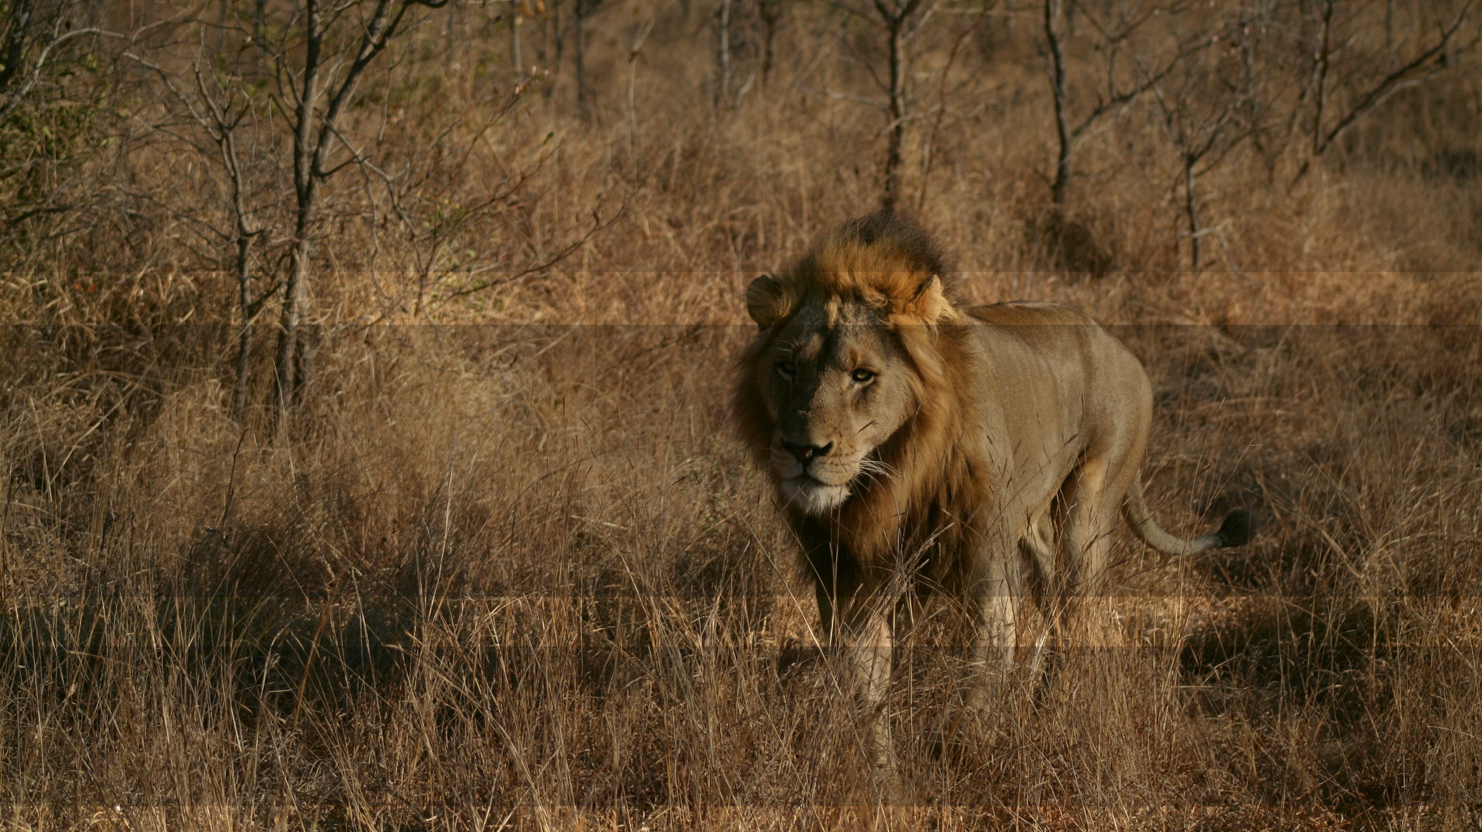







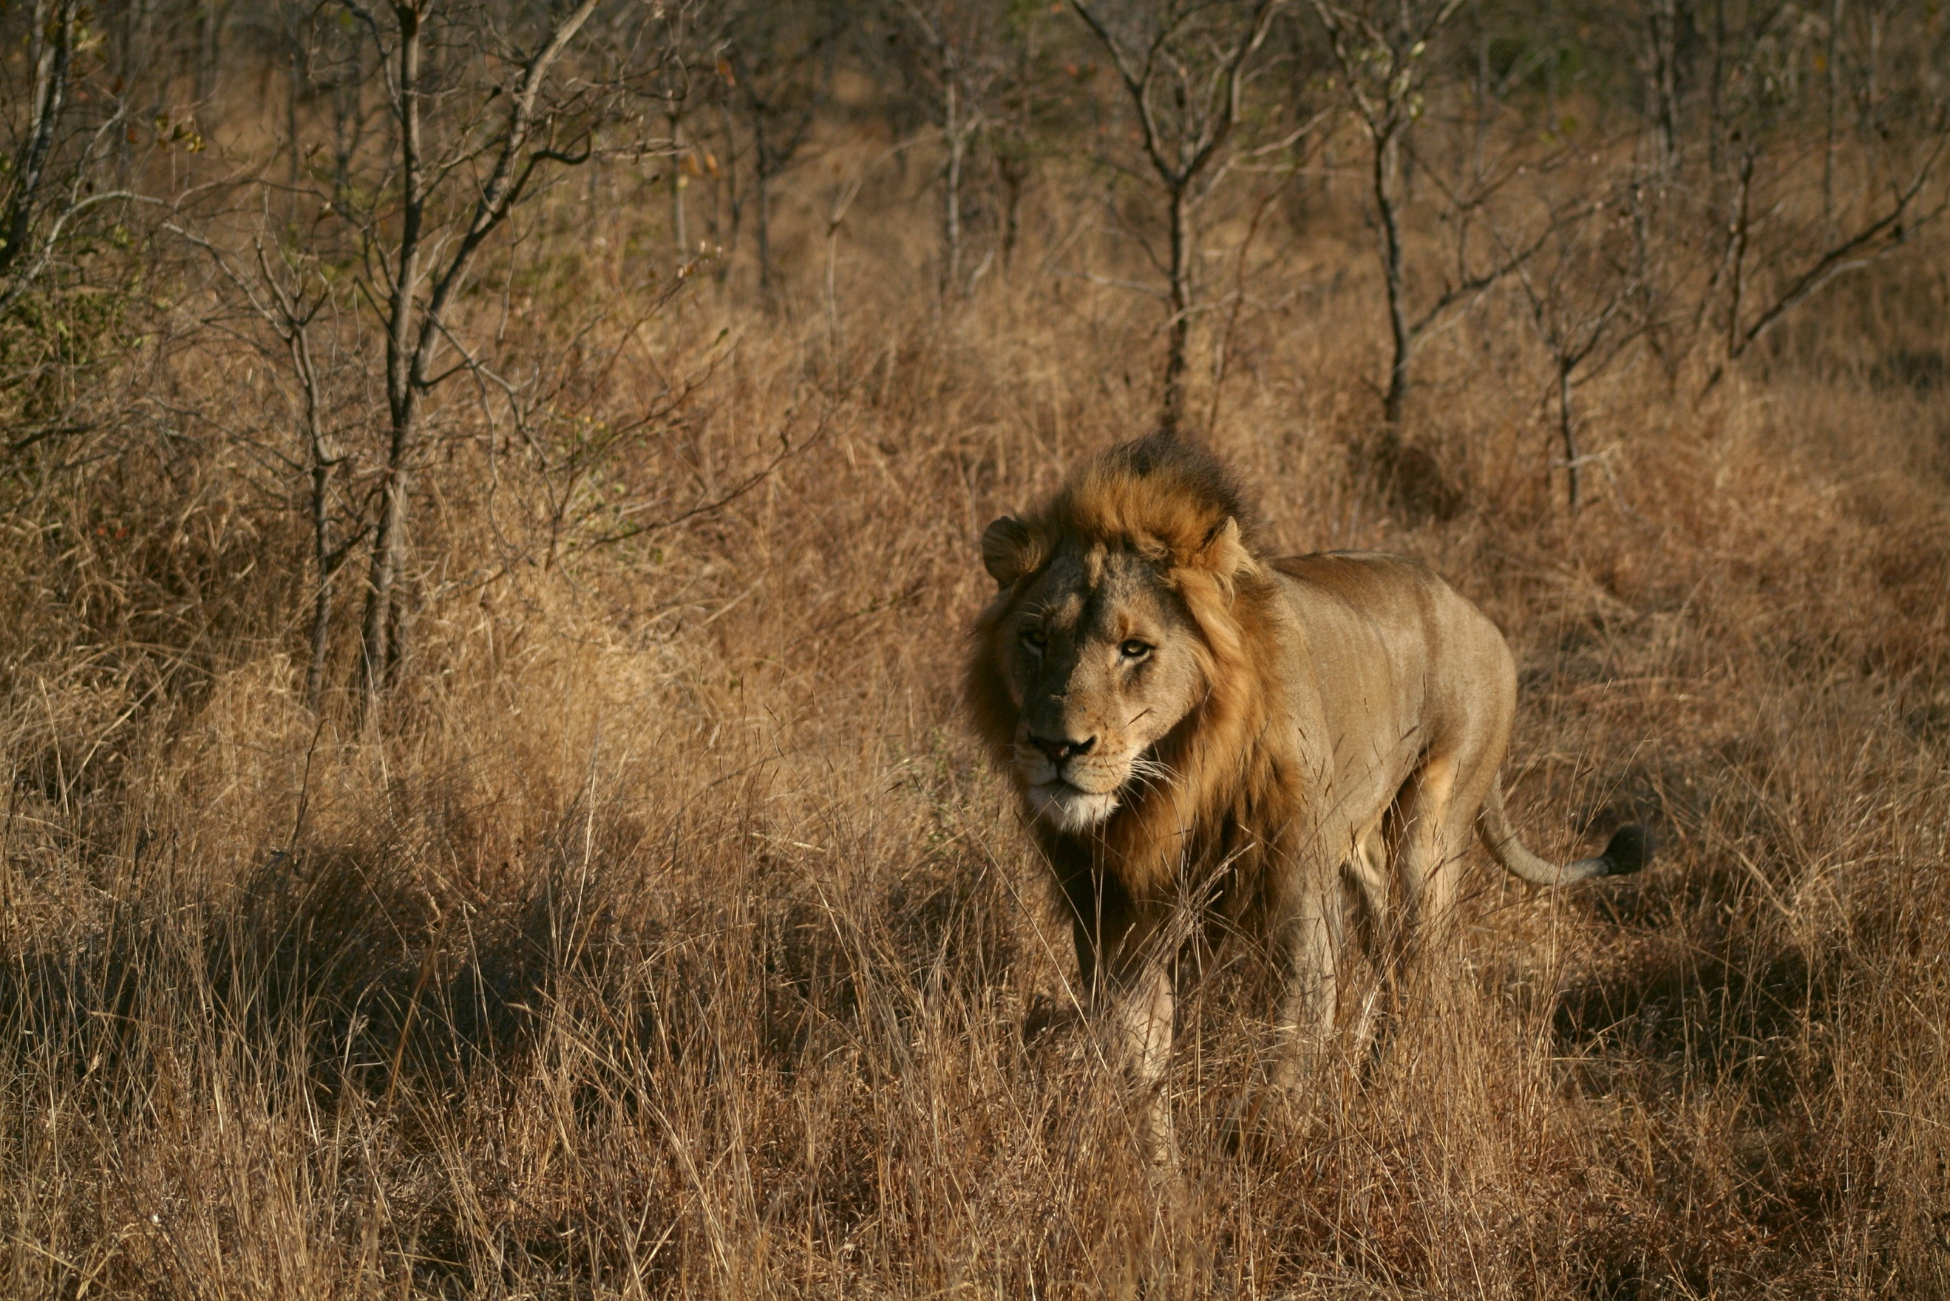


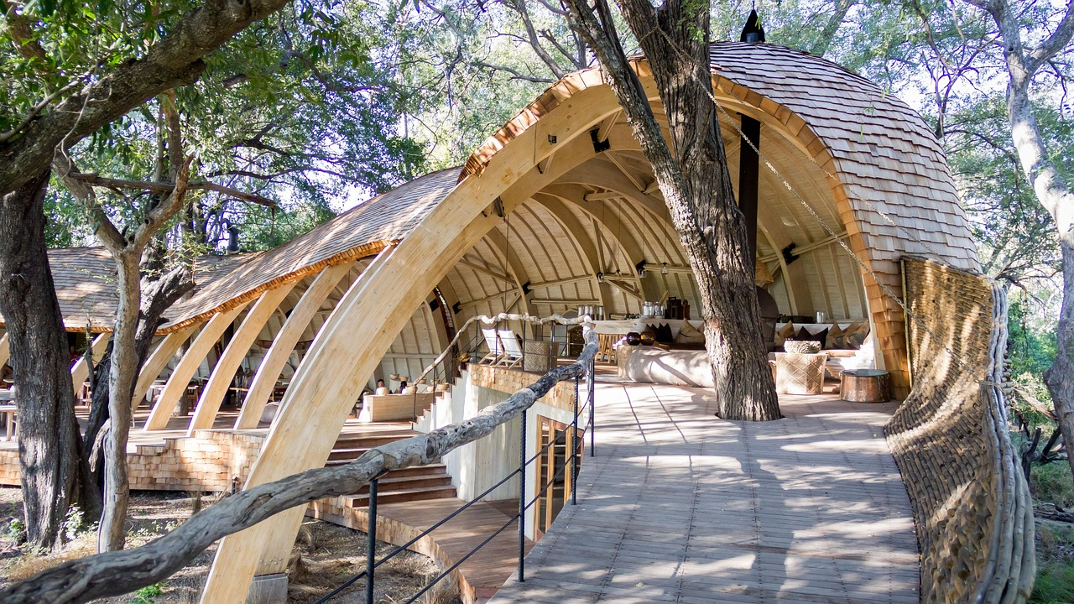



Make a quick booking
Login
ｘ
RZA
Having trouble finding something…
Home
Book a safari Ticket
Book a Night in Hotel
Visit us Today...
Terms and Conditions
Create an account
...and get a chance to get 20% off your safari tickets on first booking
Login
Accessibility Settings
Animals to see at safari
All Legal: About RZA
Sections should clearly be separated by lines or page breaks followed by relevant headings, giving space to read and distinguish content.
Sections should clearly be separated by lines or page breaks followed by relevant headings, giving space to read and distinguish content.
Report an Issue
Upcoming Events
Sites to see
Learning and More
Your First Time
What if I want a school visit?
Sections should clearly be separated by lines or page breaks followed by relevant headings, giving space to read and distinguish content. Sections should clearly be separated by lines or page breaks followed by relevant headings, giving space to read and distinguish content.
Sections should clearly be separated by lines or page breaks followed by relevant headings
Why do I need an account?
Sections should clearly be separated by lines or page breaks followed by relevant headings
Sections should clearly be separated by lines or page breaks followed by relevant headings, giving space to read and distinguish content.
I’m ready to Tour.
Privacy Policy
Like what you see?
Environmental Policy
Sections should clearly be separated by lines or page breaks followed by relevant headings
Address
Customer Policy
Head Quarters Address

Slide 2
Make a quick booking
M.Juniour
ｘ
RZA
Having trouble finding something…
Home
Book a safari Ticket
Book a Night in Hotel
Visit us Today...
Terms and Conditions
Profile Settings
...and get a chance to get 50% off your safari tickets on first booking
Accessibility Settings
Hi Martin 👋. Welcome Back
Animals to see at safari
All Legal: About RZA
Sections should clearly be separated by lines or page breaks followed by relevant headings, giving space to read and distinguish content.
Sections should clearly be separated by lines or page breaks followed by relevant headings, giving space to read and distinguish content.
Report an Issue
Upcoming Events
Sites to see
Learning and More
Your First Time
What if I want a school visit?
Sections should clearly be separated by lines or page breaks followed by relevant headings, giving space to read and distinguish content. Sections should clearly be separated by lines or page breaks followed by relevant headings, giving space to read and distinguish content.
Sections should clearly be separated by lines or page breaks followed by relevant headings
Are you on 3 visits?
Sections should clearly be separated by lines or page breaks followed by relevant headings
Sections should clearly be separated by lines or page breaks followed by relevant headings, giving space to read and distinguish content.
I’m ready to Tour.
Privacy Policy
Like what you see?
Environmental Policy
Sections should clearly be separated by lines or page breaks followed by relevant headings
Address
Customer Policy
Head Quarters Address

Slide 3
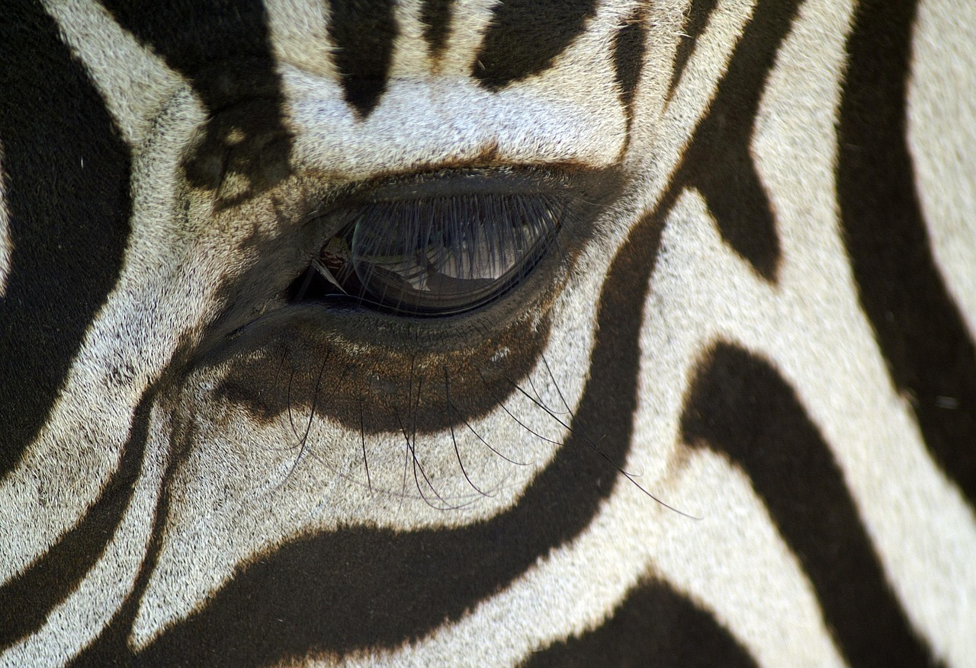
ｘ
RZA
Having trouble finding something…
Home
Welcome Back
Book a safari Ticket
Book a Night in Hotel
Login Below
Terms and Conditions
Create an account
Enter email address…
Login
I’m new to RZA
Enter password…
Accessibility Settings
All Legal: About RZA
Forgot Password
Report an Issue
Privacy Policy
Like what you see?
Environmental Policy
Sections should clearly be separated by lines or page breaks followed by relevant headings
Address
Customer Policy
Head Quarters Address

Slide 4

ｘ
RZA
Having trouble finding something…
Home
Hi There…
Book a safari Ticket
Book a Night in Hotel
Let’s get you registered.
Terms and Conditions
Sections should clearly be separated by lines or page breaks followed by relevant headings, giving space to read and distinguish content
Create an account
Login
Accessibility Settings
Start Below…
All Legal: About RZA
Report an Issue
Please read all information and enter where required.
Forgot Password
Enter First Name
Save the Rhinos
Enter Last Name
Email Address
Sections should clearly be separated by lines or page breaks followed by relevant headings, giving space to read and distinguish content
Enter Password
Sections should clearly be separated by lines or page breaks followed by relevant headings, giving space to read and distinguish content.
Confirm Password
Postal Code
I have read and accepted the terms and conditions
Create Account
Receive Marketing Emails
Privacy Policy
Like what you see?
Environmental Policy
Sections should clearly be separated by lines or page breaks followed by relevant headings
Address
Customer Policy
Head Quarters Address

Slide 5

ｘ
RZA
M.Juniour
Having trouble finding something…
Home
Hi Martin…
Book a safari Ticket
Thank you for creating an account with RZA.
Welcome to the Club!
Book a Night in Hotel
Terms and Conditions
Continue /
Make a Hotel Booking
Have a Visit to our State of the Art Safari
Manage your Profile
Profile Settings
Accessibility Settings
Go back Home
All Legal: About RZA
Report an Issue
Privacy Policy
Like what you see?
Environmental Policy
Sections should clearly be separated by lines or page breaks followed by relevant headings
Address
Customer Policy
Head Quarters Address

Slide 6
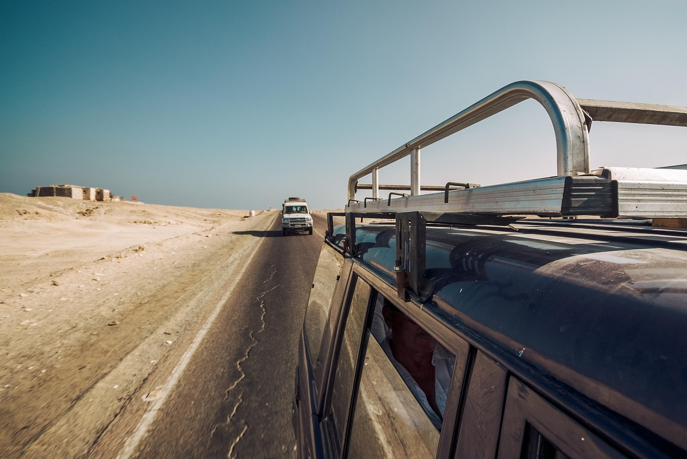
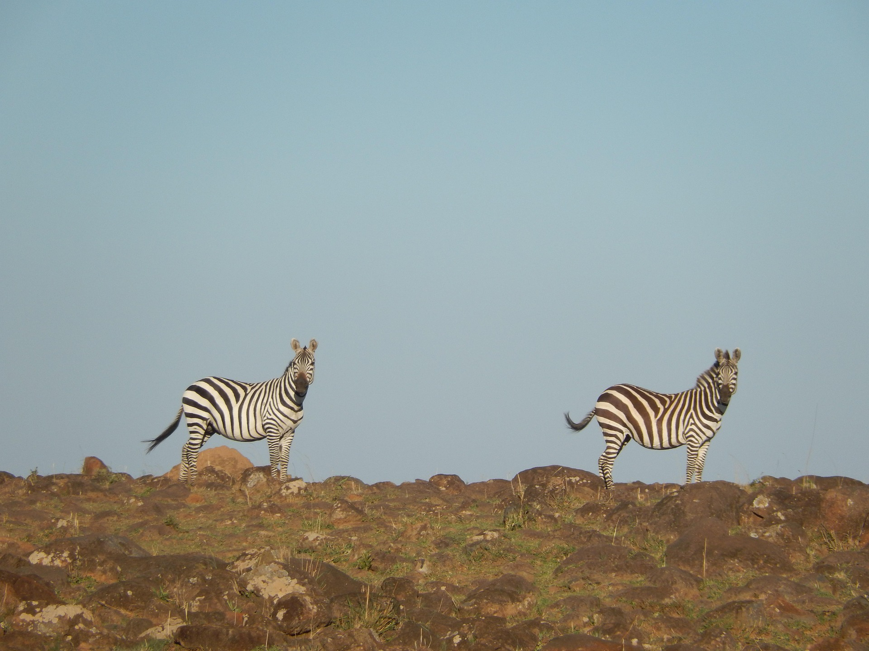
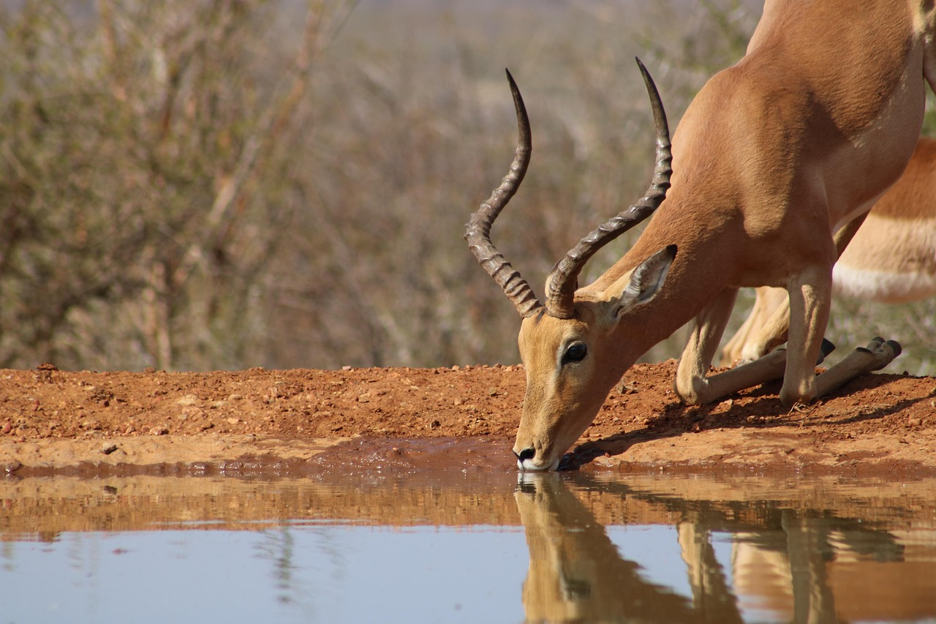
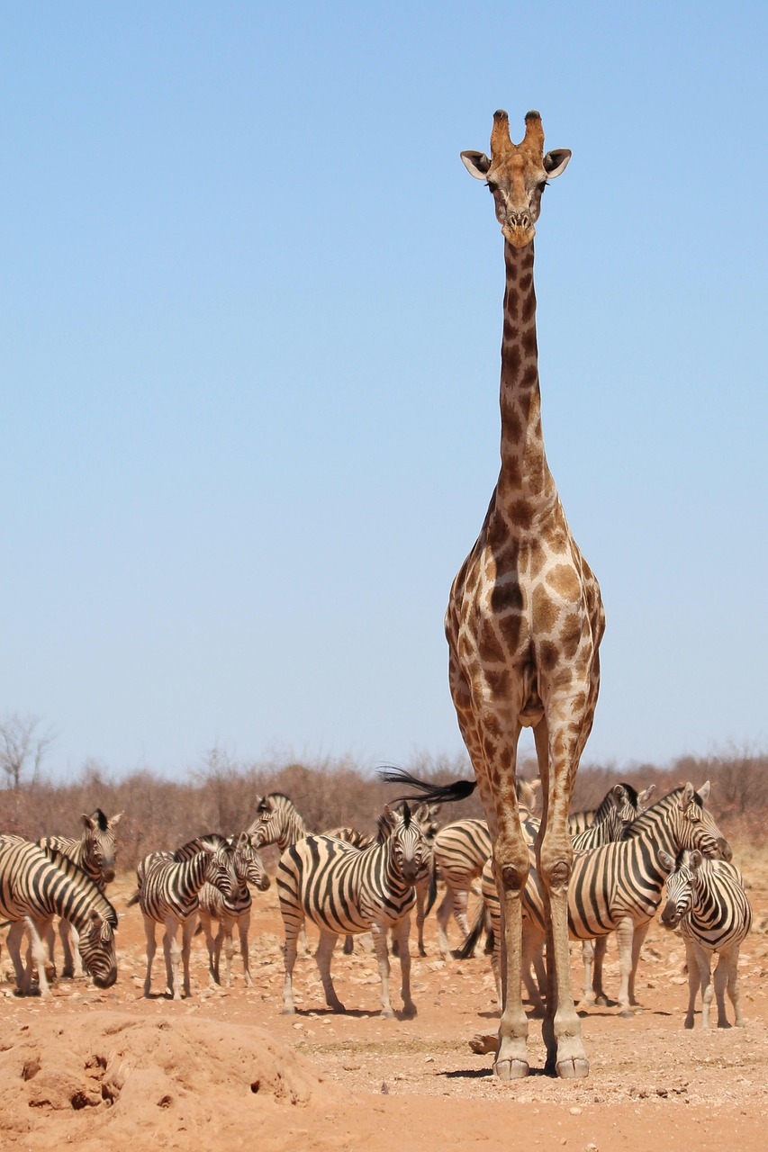

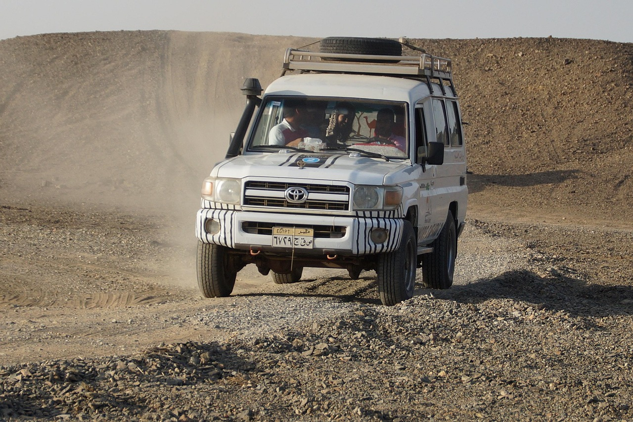


M.Juniour
ｘ
RZA
Having trouble finding something…
Home
Book a safari Ticket
Booking a safari visit has never been easier.
Book a Night in Hotel
Terms and Conditions
Profile Settings
Accessibility Settings
Let's Begin Below
All Legal: About RZA
Report an Issue
Enter First Name
Enter Last Name
Date of Visitation
Number of Tickets
^
1
^
Proceed to Payment
£26.99
Per ticket
Privacy Policy
Like what you see?
Environmental Policy
Sections should clearly be separated by lines or page breaks followed by relevant headings
Address
Customer Policy
Head Quarters Address

Slide 7
Create Account
ｘ
RZA
Having trouble finding something…
Home
Book a safari Ticket
Booking a safari visit has never been easier.
Book a Night in Hotel
Terms and Conditions
Create an account
Login
Let's Begin Below
Accessibility Settings
All Legal: About RZA
Report an Issue
Enter First Name
Enter Last Name
Date of Visitation
Number of Tickets
^
1
^
Proceed to Payment
£26.99
Per ticket
Privacy Policy
Like what you see?
Environmental Policy
Sections should clearly be separated by lines or page breaks followed by relevant headings
Address
Customer Policy
Head Quarters Address

Slide 8
Create Account
ｘ
RZA
Having trouble finding something…
Home
Book a safari Ticket
Safari Tickets Confirmation.
Please input Payment Details Below
Book a Night in Hotel
Full Name
Terms and Conditions
Sort Code
Create an account
Pay £26.99
+ 32 Points
Login
Account Number
Accessibility Settings
CVV Code
All Legal: About RZA
What is a CVV?
Report an Issue
I confirm the above details are correct and my bank is to be charged the agreed amount by RZA.
Privacy Policy
Like what you see?
Environmental Policy
Sections should clearly be separated by lines or page breaks followed by relevant headings
Address
Customer Policy
Head Quarters Address

Slide 9
Create Account
ｘ
RZA
Having trouble finding something…
Home
Congratulations.
Book a safari Ticket
Book a Night in Hotel
Terms and Conditions
Your Ticket Purchase was successful.
Below is your reference number for the ticket booking. You can always find this in your profile management Tab if you have an RZA account. See verification email for further details about cancellations and more.
Create an account
Login
Accessibility Settings
All Legal: About RZA
#79026-992-2025MKO
Report an Issue
Privacy Policy
Like what you see?
Environmental Policy
Sections should clearly be separated by lines or page breaks followed by relevant headings
Address
Customer Policy
Head Quarters Address

Slide 10
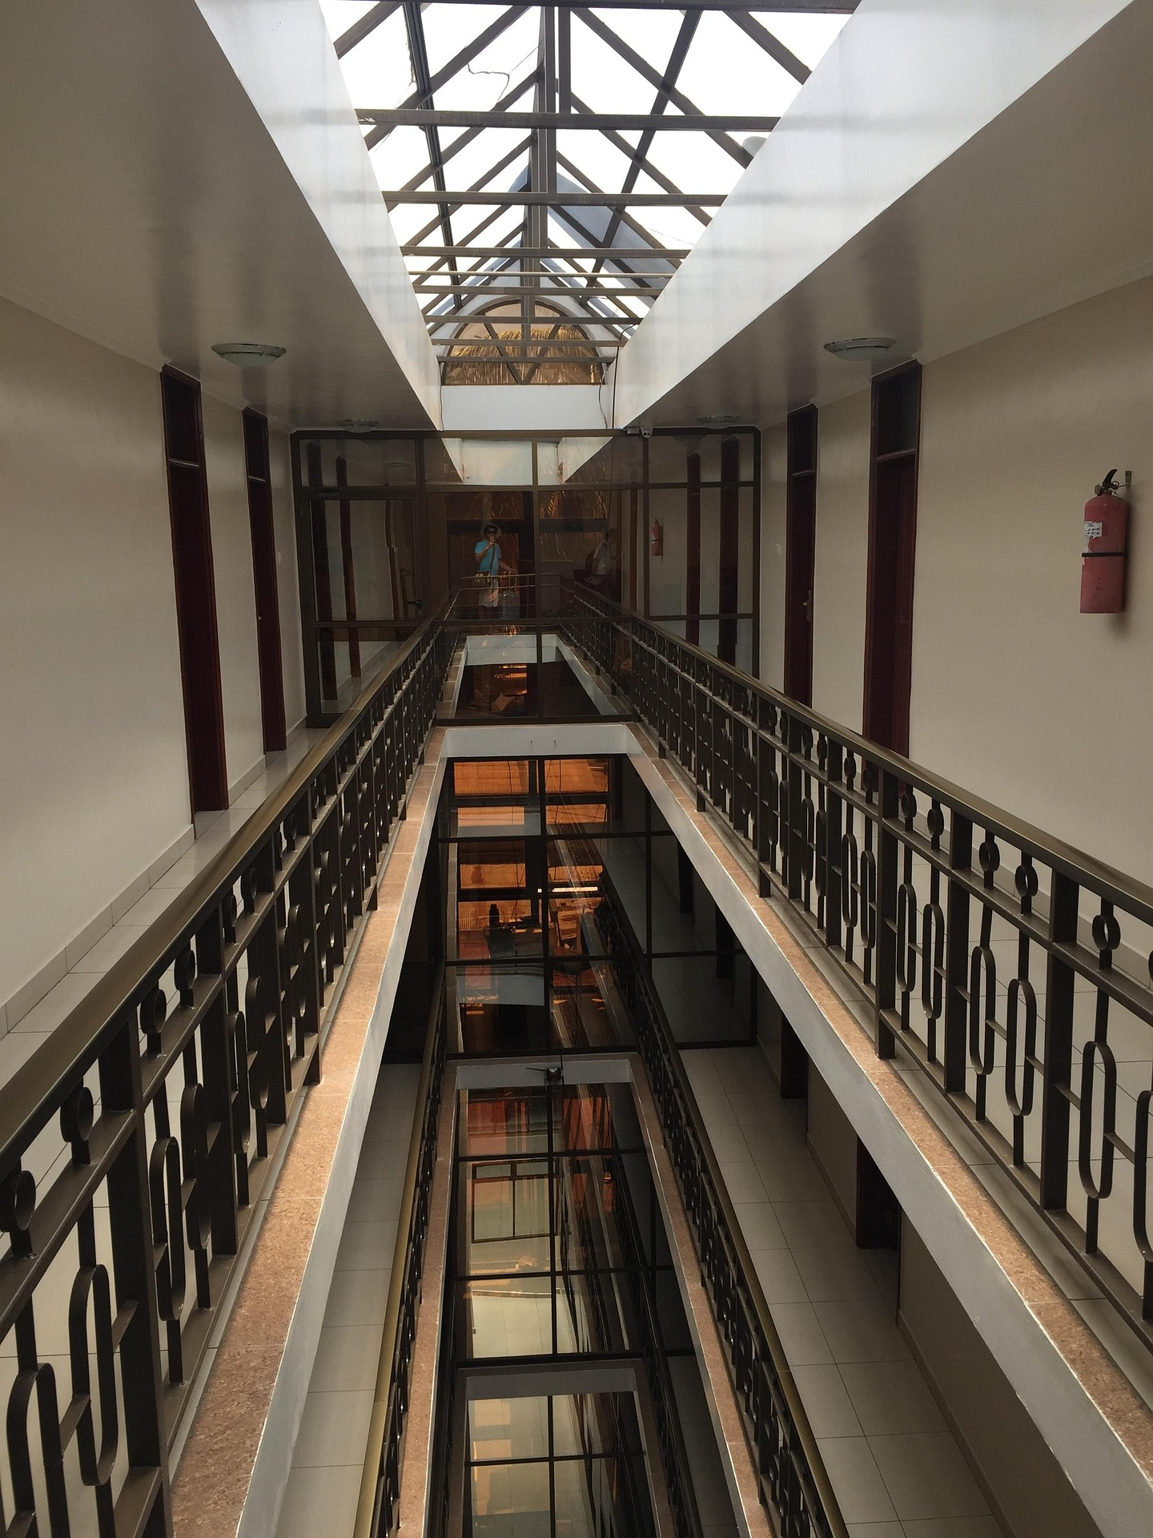
Create Account
ｘ
RZA
Having trouble finding something…
Home
Book a safari Ticket
Book a Night in Hotel
Fancy a night under the sky…
Terms and Conditions
…or a safari themed stroll in the day…
Create an account
Login
Accessibility Settings
Next →
All Legal: About RZA
Report an Issue
Privacy Policy
Like what you see?
Environmental Policy
Sections should clearly be separated by lines or page breaks followed by relevant headings
Address
Customer Policy
Head Quarters Address

Slide 11
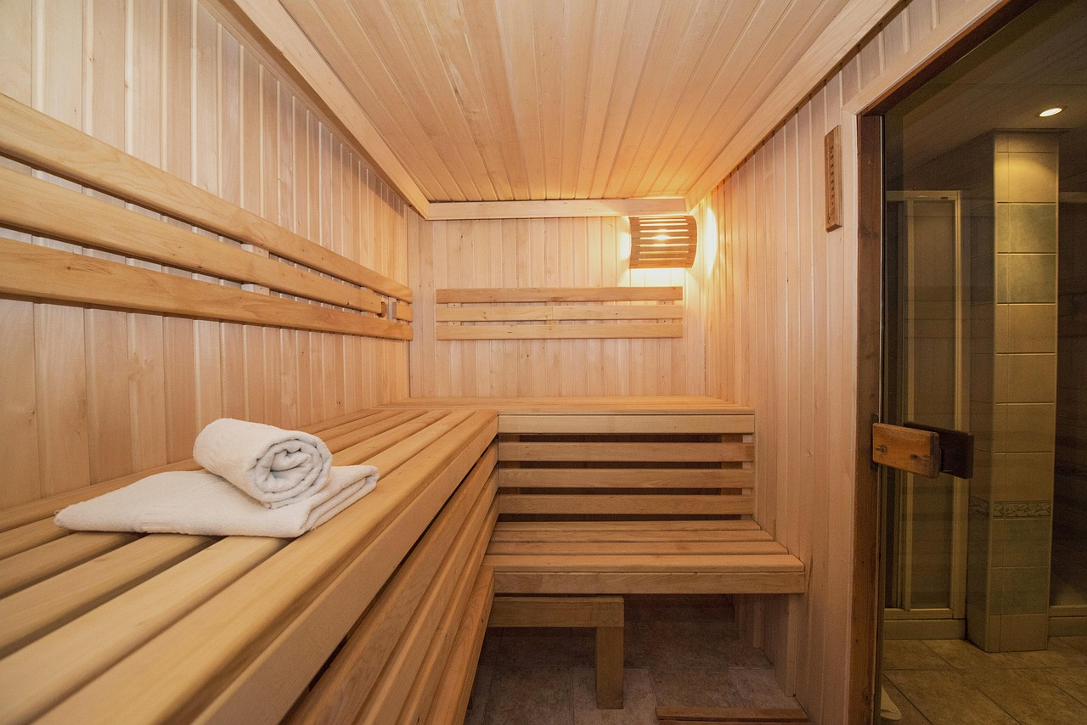
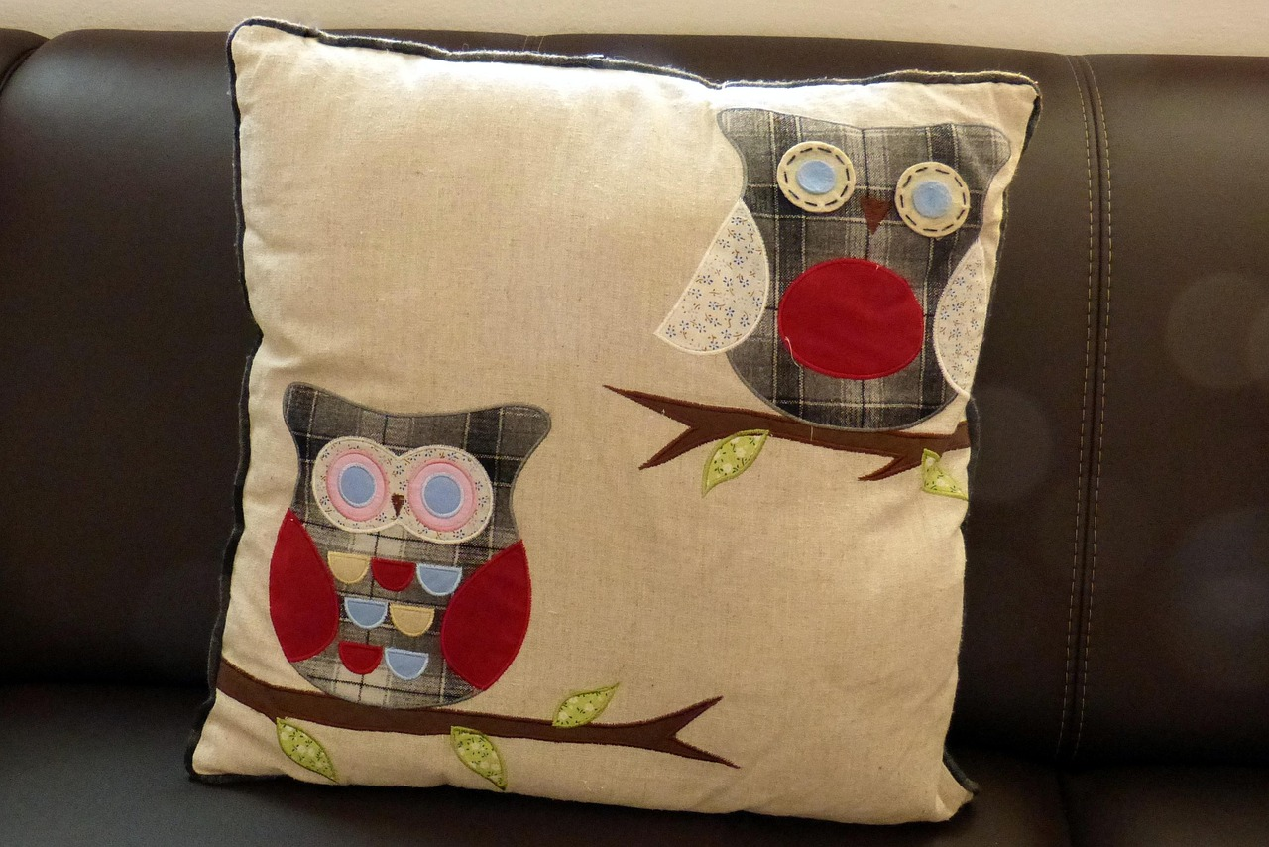

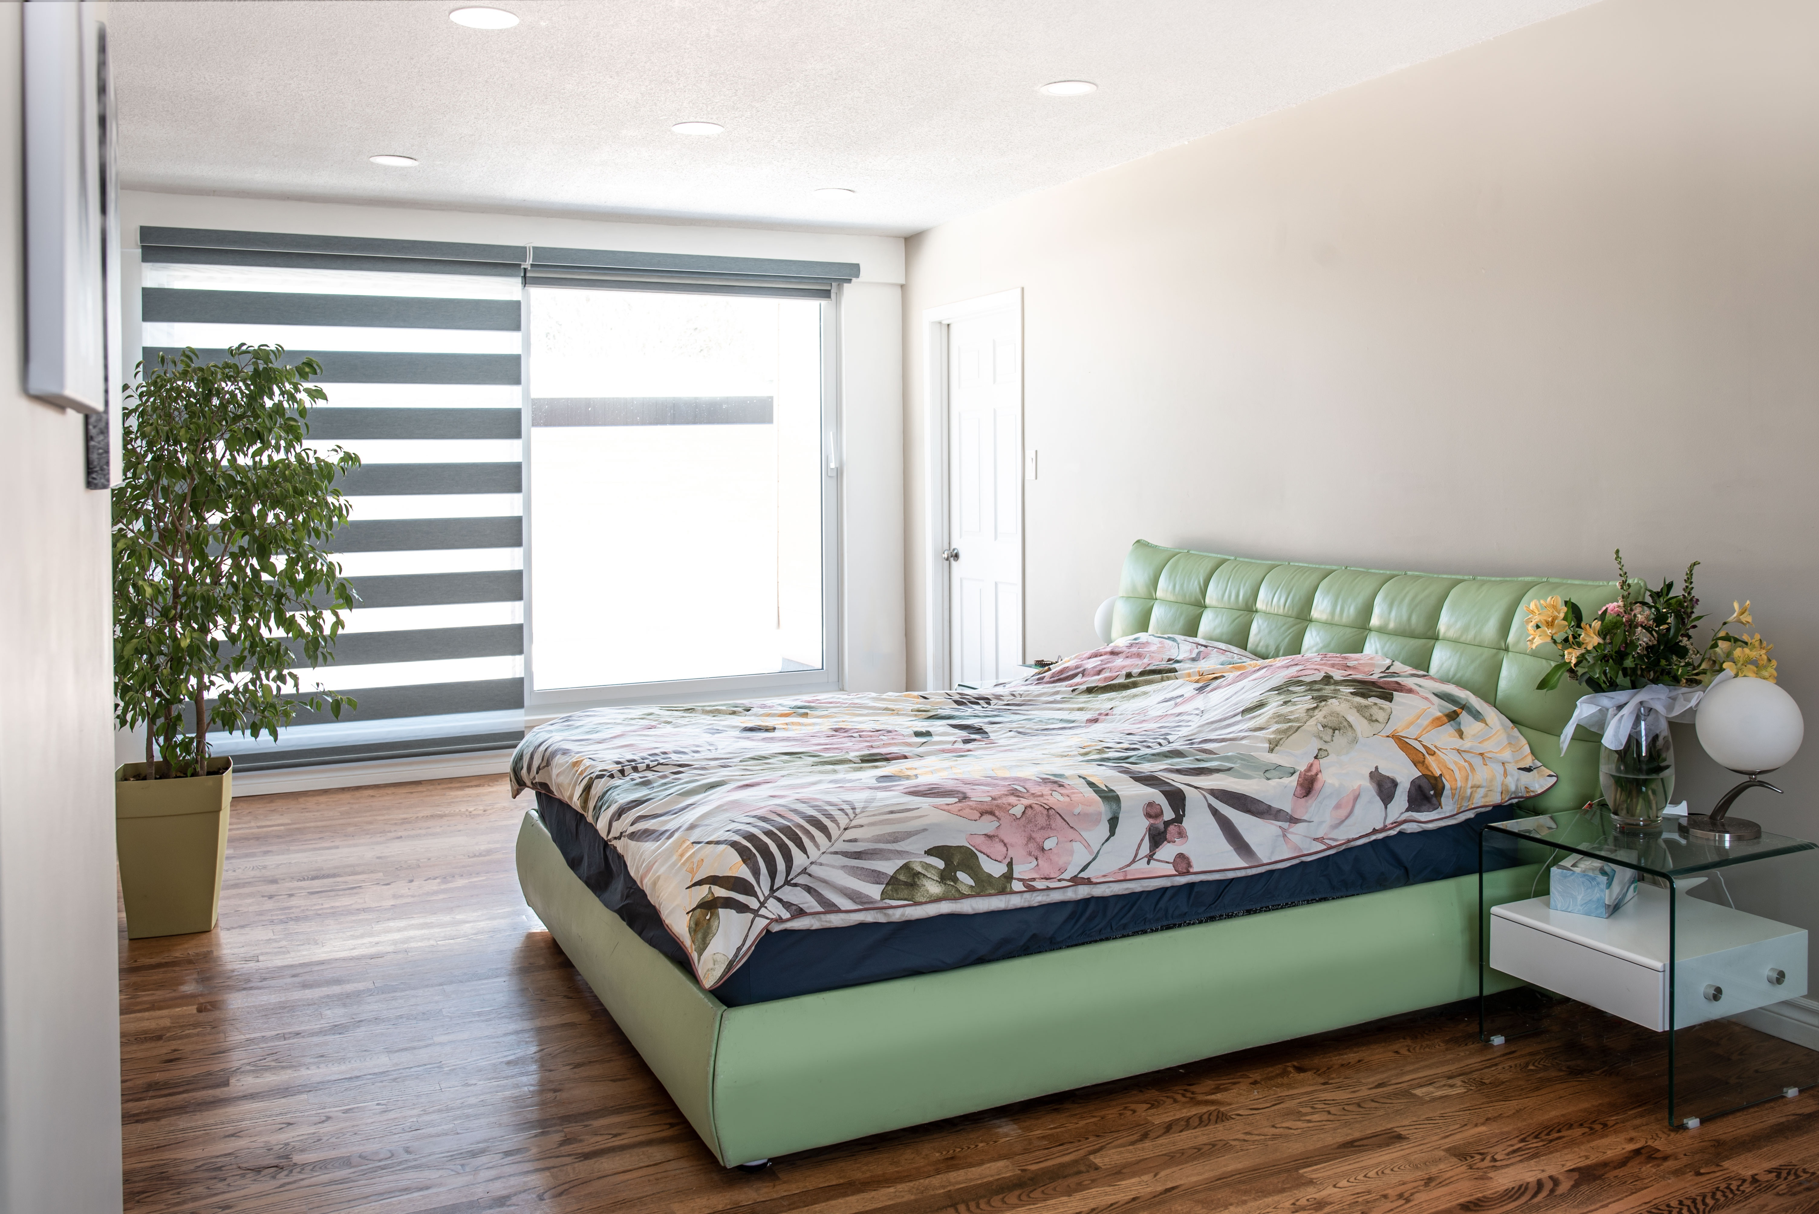
Create Account
ｘ
RZA
Having trouble finding something…
Home
Book for up to a week in our hotel.
Book a safari Ticket
Sections should clearly be separated by lines or page breaks followed by relevant headings, giving space to read and distinguish content. Sections should clearly be separated by lines or page breaks followed by relevant headings, giving space to read and distinguish content.
Book a Night in Hotel
Terms and Conditions
Create an account
Enter First Name
Login
Accessibility Settings
Enter Last Name
All Legal: About RZA
Report an Issue
Email Address
Range of Visit
Suggested Room type based on number of visitors.
Double Bed : Large (4.5m x 4.5m)
→
Number of Visitors
Number of Rooms
Sections should clearly be separated by lines or page breaks followed by relevant headings, giving space to read and distinguish content. Sections should clearly be separated by lines or page breaks followed by relevant headings, giving space to read and distinguish content.
I have read and accepted the above terms before making my booking.
Proceed to Payment
Privacy Policy
Like what you see?
Environmental Policy
Sections should clearly be separated by lines or page breaks followed by relevant headings
Address
Customer Policy
Head Quarters Address

Slide 12

Create Account
ｘ
RZA
Having trouble finding something…
Home
Ooops!
Book a safari Ticket
Book a Night in Hotel
Terms and Conditions
Create an account
Let’s you get you logged in before making your booking.
Login
Accessibility Settings
Don’t have an account?
Don’t worry, it only takes 5 min to make one
Log in
All Legal: About RZA
Report an Issue
Create an Account
Privacy Policy
Like what you see?
Environmental Policy
Sections should clearly be separated by lines or page breaks followed by relevant headings
Address
Customer Policy
Head Quarters Address

Slide 13

ｘ
RZA
M.Juniour
Having trouble finding something…
Home
Book a safari Ticket
Hotel Booking for Martin Juniour
Book a Night in Hotel
Date of Stay :
19 November 2023 – 23 November 2023
Number of Rooms :
2
Terms and Conditions
Amount (Due today() ):
£ 450.98
Profile Settings
You have 271+ Loyalty Points
Accessibility Settings
Use Points (£67.09) off
All Legal: About RZA
Pay £383.89
Go back
Report an Issue
Privacy Policy
Like what you see?
Environmental Policy
Sections should clearly be separated by lines or page breaks followed by relevant headings
Address
Customer Policy
Head Quarters Address

Slide 14
ｘ
RZA
M.Juniour
Having trouble finding something…
Home
Book a safari Ticket
Hotel Booking for Martin Juniour
Please input Payment Details Below
Book a Night in Hotel
Full Name
Terms and Conditions
Sort Code
Pay £383.89
Profile Settings
Account Number
Accessibility Settings
CVV Code
All Legal: About RZA
What is a CVV?
Report an Issue
I confirm the above details are correct and my bank is to be charged the agreed amount by RZA.
Privacy Policy
Like what you see?
Environmental Policy
Sections should clearly be separated by lines or page breaks followed by relevant headings
Address
Customer Policy
Head Quarters Address

Slide 15
Create Account
ｘ
RZA
Having trouble finding something…
Home
Congrats Martin
Book a safari Ticket
Book a Night in Hotel
Terms and Conditions
Your Booking was created successfully.
Below is your reference number for the booking. You can always find this in your profile management Tab. See verification email for further details.
Create an account
Login
Accessibility Settings
#46824-248-2042BAC
All Legal: About RZA
Report an Issue
Privacy Policy
Like what you see?
Environmental Policy
Sections should clearly be separated by lines or page breaks followed by relevant headings
Address
Customer Policy
Head Quarters Address

Slide 16
ｘ
Home
RZA
Having trouble finding something…
Home
Book a safari Ticket
Good Afternoon, Martin
Book a Night in Hotel
Edit your Profile
Terms and Conditions
Messages
Hotel Bookings
Profile Settings
You have 2 Bookings
Hi There, from RZA👋🏼
Accessibility Settings
Tickets
All Legal: About RZA
10 days Until your next Safari visit
Report an Issue
Privacy Policy
Like what you see?
Environmental Policy
Sections should clearly be separated by lines or page breaks followed by relevant headings
Address
Customer Policy
Head Quarters Address

Slide 17
ｘ
Home
RZA
Having trouble finding something…
Home
Good Afternoon, Martin
Book a safari Ticket
Book a Night in Hotel
Edit your Profile
First Name
Terms and Conditions
Martin
Profile Settings
Messages
Last Name
Accessibility Settings
Juniour
All Legal: About RZA
Email Address
Hotel Bookings
example@martin.com
Report an Issue
You have 2 Bookings
Password
- - - - - - - - -
Edit your profile Here.
Post Code
LE10 1WQ
Tickets
Marketing
10 days Until your next Safari visit
Receive Marketing Emails
Change
Delete Account Instead
Privacy Policy
Like what you see?
Environmental Policy
Sections should clearly be separated by lines or page breaks followed by relevant headings
Address
Customer Policy
Head Quarters Address

Slide 18
ｘ
Home
RZA
Having trouble finding something…
Home
Book a safari Ticket
Good Afternoon, Martin
Book a Night in Hotel
Edit your Profile
You are about to delete your account.
←
Terms and Conditions
Messages
Hotel Bookings
Profile Settings
You have 2 Bookings
Martin Juniour
Accessibility Settings
Tickets
All Legal: About RZA
10 days Until your next Safari visit
Confirm Deletion
Report an Issue
Privacy Policy
Like what you see?
Environmental Policy
Sections should clearly be separated by lines or page breaks followed by relevant headings
Address
Customer Policy
Head Quarters Address

Slide 19
ｘ
Home
RZA
Having trouble finding something…
Home
Book a safari Ticket
Good Afternoon, Martin
Book a Night in Hotel
Edit your Profile
You have 1 New Notification.
Terms and Conditions
Messages
Hotel Bookings
Profile Settings
+
You have 2 Bookings
Sections should clearly be separated by lines or page…
19/11/2025
Accessibility Settings
Tickets
All Legal: About RZA
10 days Until your next Safari visit
Sections should clearly be separated by lines or page…
24/11/2025
Report an Issue
Privacy Policy
Like what you see?
Environmental Policy
Sections should clearly be separated by lines or page breaks followed by relevant headings
Address
Customer Policy
Head Quarters Address

Slide 20
ｘ
Home
RZA
Having trouble finding something…
Home
Good Afternoon, Martin
Book a safari Ticket
Book a Night in Hotel
Edit your Profile
Terms and Conditions
Martin’s Hotel Bookings
Messages
Profile Settings
Hotel Bookings
No.
Check In
Check Out
Reference Number
Accessibility Settings
You have 2 Bookings
1
19/11/2025
26/11/2025
#46824-248-2042BAC
Edit
Delete
All Legal: About RZA
2
19/11/2025
24/11/2025
#46824-248-2042BAC
Edit
Delete
Report an Issue
Tickets
3
How did we Do?
19/11/2025
24/11/2025
#46824-248-2042BAC
10 days Until your next Safari visit
You have 271+ Loyalty Points
Privacy Policy
Like what you see?
Environmental Policy
Sections should clearly be separated by lines or page breaks followed by relevant headings
Address
Customer Policy
Head Quarters Address

Slide 21
ｘ
Home
RZA
Having trouble finding something…
Home
Good Afternoon, Martin
Book a safari Ticket
Book a Night in Hotel
Edit your Profile
You have 271+ Loyalty Points
Terms and Conditions
Messages
Martin’s Safari Visits.
Profile Settings
Hotel Bookings
Accessibility Settings
You have 2 Bookings
No.
Visit
Reference Number
All Legal: About RZA
Tickets
1
19/11/2025
#46824-248-2042BAC
Edit
Delete
Report an Issue
10 days Until your next Safari visit
3
19/11/2025
How did we Do on this one?
#46824-248-2042BAC
Privacy Policy
Like what you see?
Environmental Policy
Sections should clearly be separated by lines or page breaks followed by relevant headings
Address
Customer Policy
Head Quarters Address

Slide 22
Create Account
ｘ
RZA
Having trouble finding something…
Home
Accessibility
Book a safari Ticket
Book a Night in Hotel
Font Size
Medium (Default)
Terms and Conditions
>
Display Theme
Light Mode (Default)
Create an account
>
Login
View Images
i
Accessibility Settings
Bold Text
i
All Legal: About RZA
Report an Issue
Save and Apply
Privacy Policy
Like what you see?
Environmental Policy
Sections should clearly be separated by lines or page breaks followed by relevant headings
Address
Customer Policy
Head Quarters Address

Slide 23
ｘ
M.Juniour
RZA
Having trouble finding something…
Home
Accessibility
Book a safari Ticket
Book a Night in Hotel
Font Size
Medium (Default)
>
Terms and Conditions
Display Theme
Light Mode (Default)
>
Profile Settings
View Images
i
Accessibility Settings
Bold Text
i
All Legal: About RZA
Report an Issue
Save and Apply
Privacy Policy
Like what you see?
Environmental Policy
Sections should clearly be separated by lines or page breaks followed by relevant headings
Address
Customer Policy
Head Quarters Address

